Slide 1
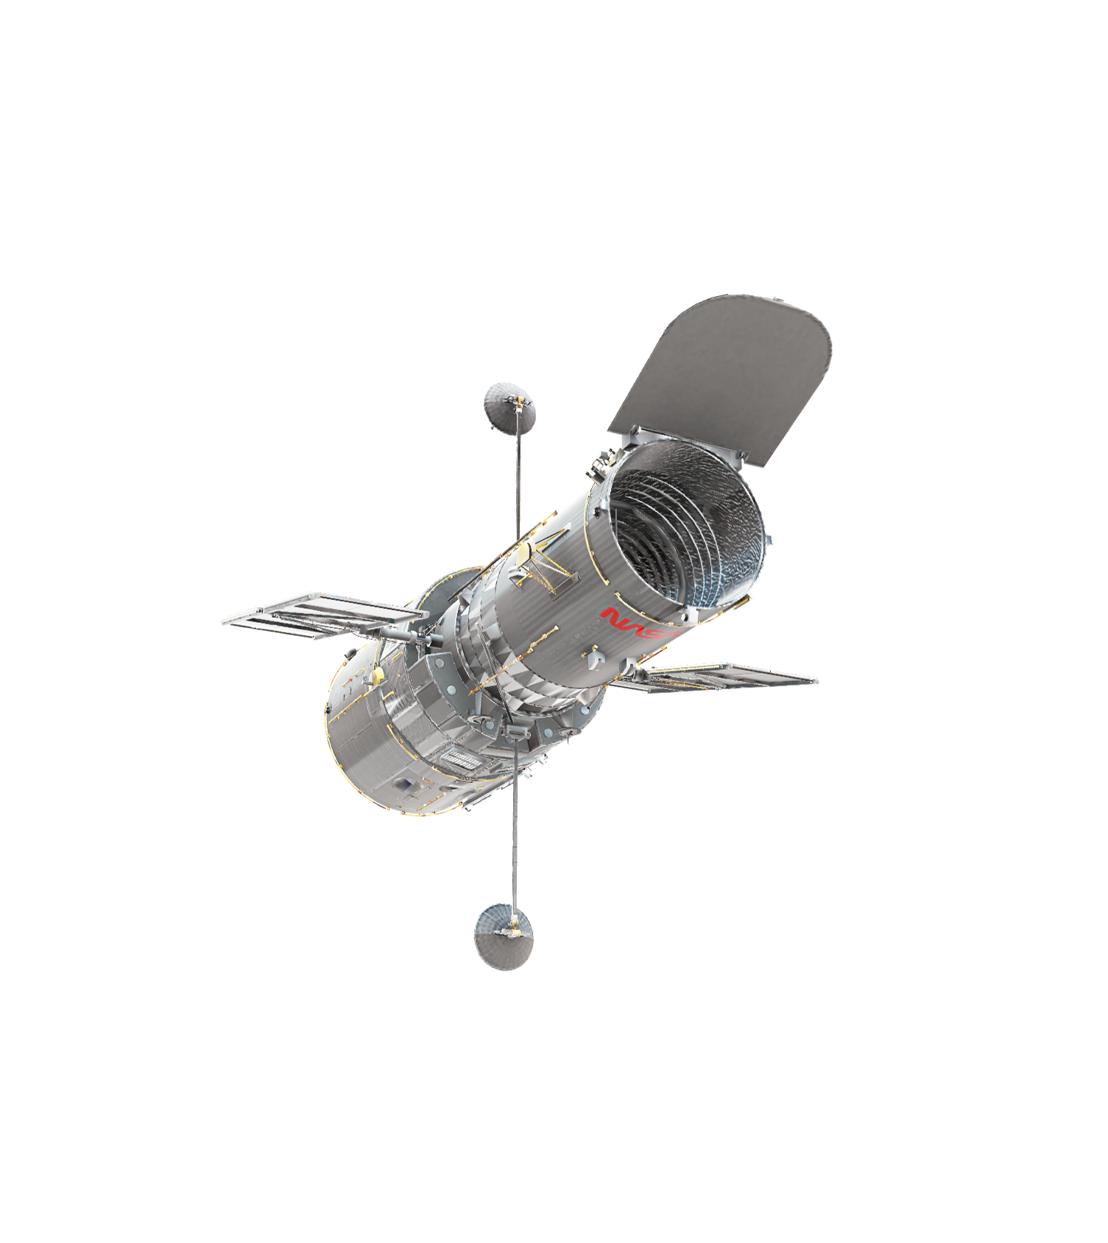
Slide 1
ABOUT THIS DECK
Office subscribers can add 3D models to documents and rotate the angle to show the right view. If you don’t have a subscription, the document simply shows a single view.
This template includes examples of different views of the same 3D model. Try adjusting the views or adding in new models. Learn how

Slide 2
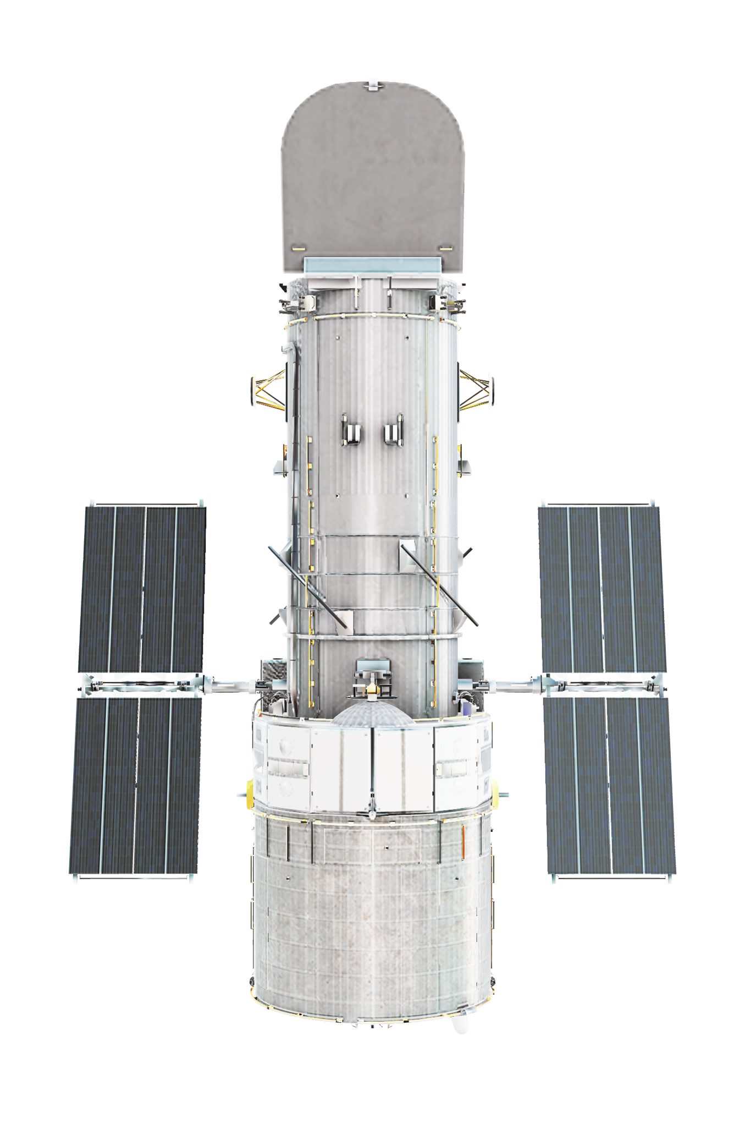

SOLAR PANELS
Named after the famous American astronomer Edwin Hubble, the Hubble telescope is powered by six nickel-hydrogen batteries, which provide power to the spacecraft during orbit while it flies through the Earth’s shadow. The scientific instrumentation and onboard computers draw approximately 2800 watts, which are charged by two 2.45 x 7.56m solar panels.

Slide 3
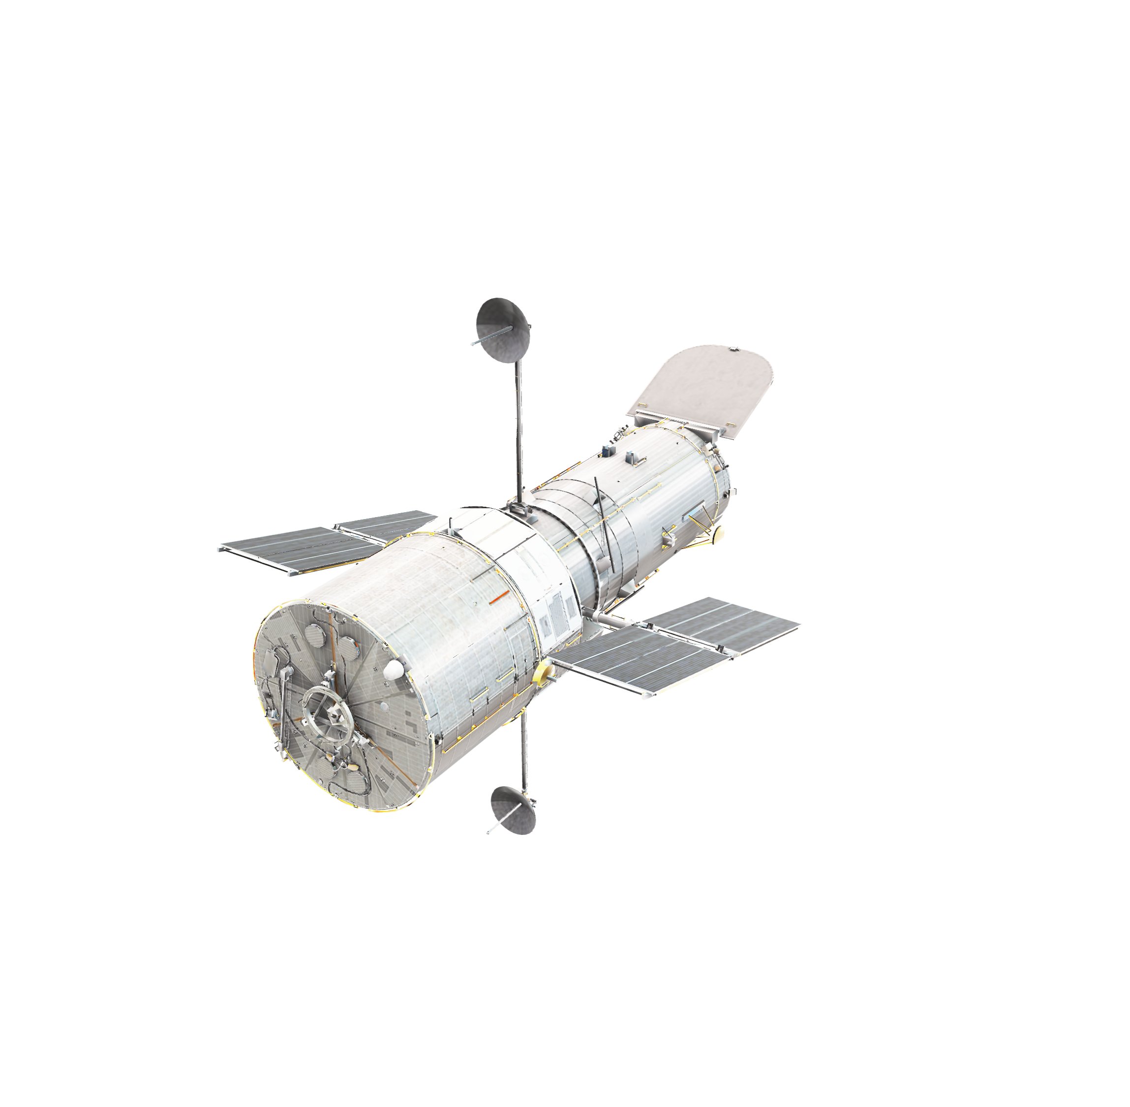
COMMUNICATIONS ANTENNAS
On-board the Hubble telescope are two identical S-Band transmitters. In 1998 one of the transmitters failed, however the secondary transmitter has kept up with the extra load by rotating the telescope to maintain communication. The radio waves converted from the solid-state recording system are sent to a NASA communication satellite, which in-turn relays the information to Earth.

Slide 4
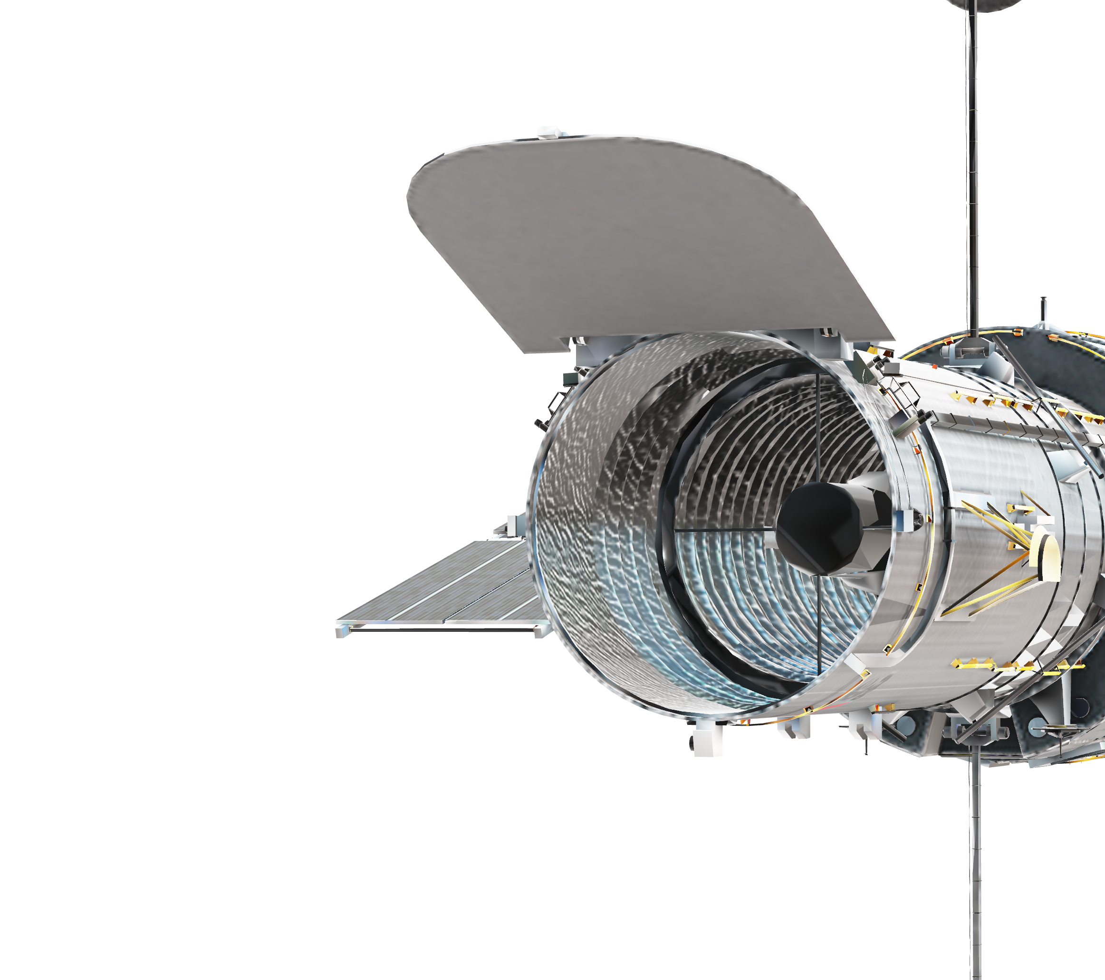
APERTURE DOOR
The adaptive optics on the Hubble telescope allow it to conduct high-resolution optical visualization over a wide field of view. The aperture door itself can be closed if needed, to prevent light from external sources from entering the telescope.

Slide 5
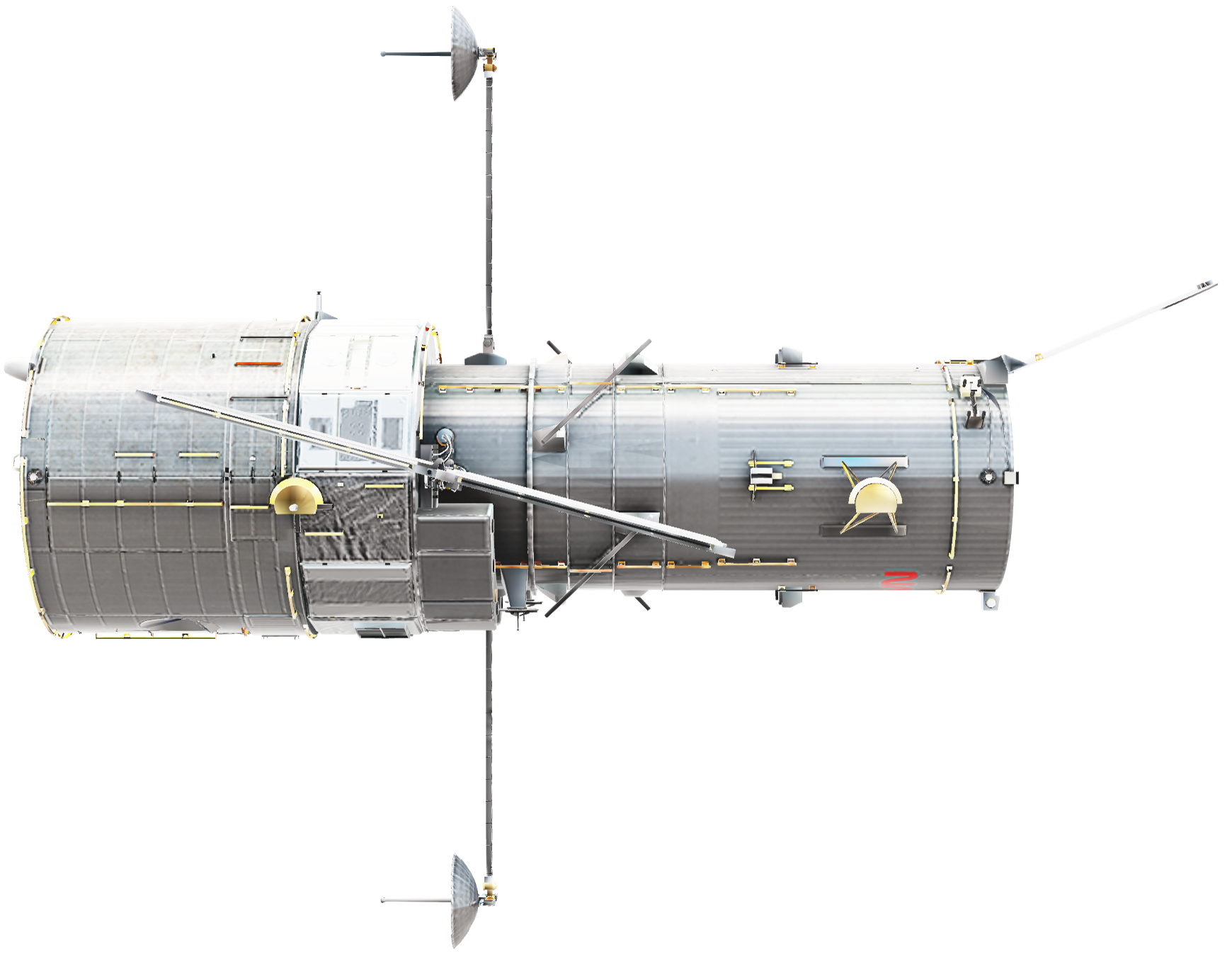
LENGTH 13.2m
DIAMETER 2.4m

